Slide 1
CATERING Practical Activity
EQ – How to organise and plan for a range of events in a cost- effective way?
Mrs James
Year 11

Slide 2

Learning Intentions
Students will be able to
Collect, organise and communicate information effectively
WICOR

Slide 3
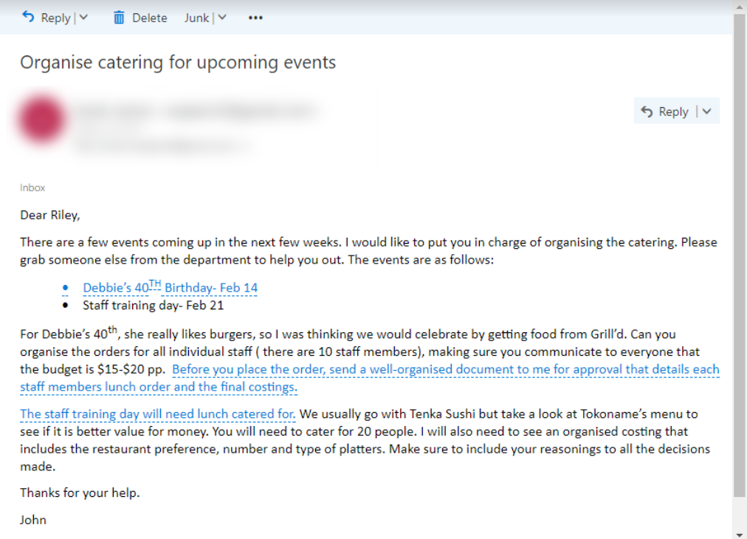
24
7
30
Catering- Practical Activity
Date:
EQ – How to organise and plan for a range of events in a cost- effective way?
You will be working for a small business in an administration position.
You have just received the following email
Question

Slide 4
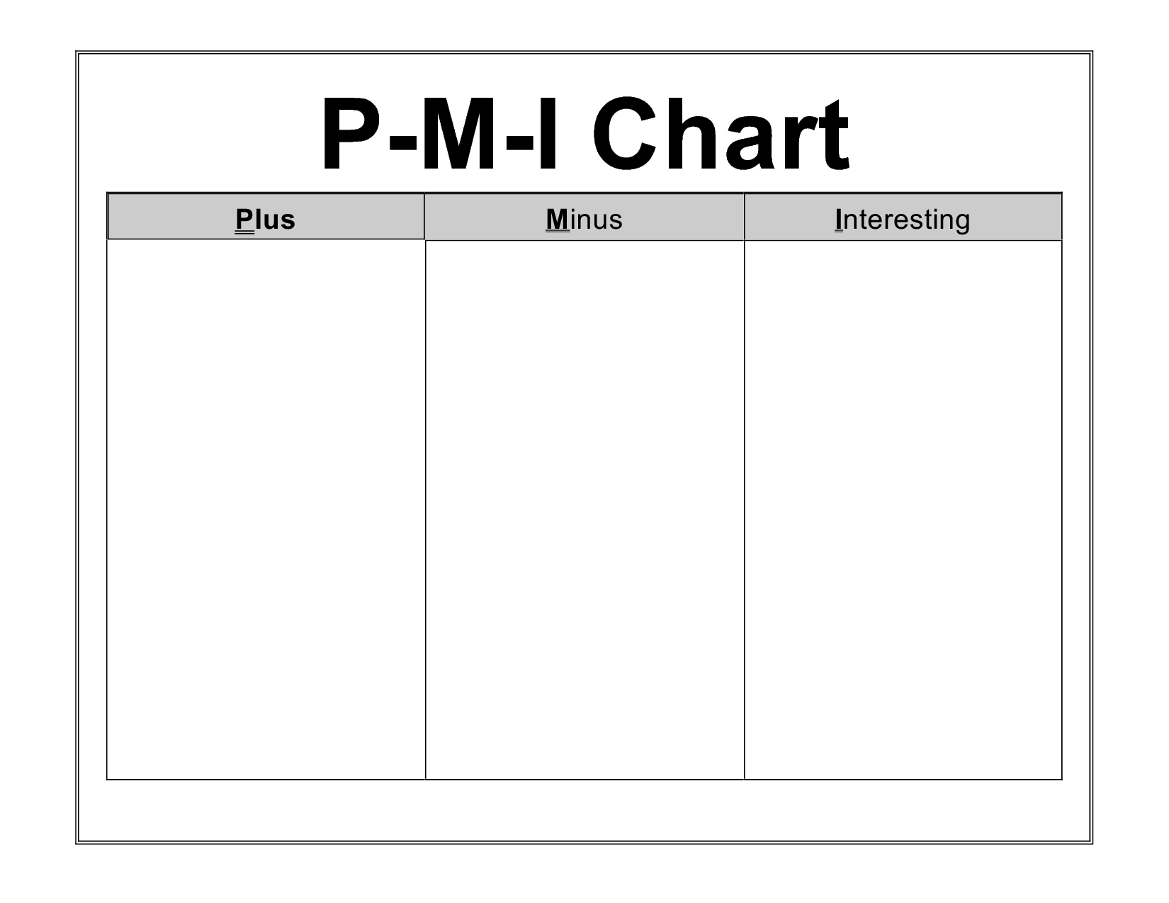
24
7
30
Catering- Practical Activity
Date:
EQ – How to organise and plan for a range of events in a cost- effective way?
Student feedback
Gallery walk
Blu-tak your emails around the room
Each pair is then to post a sticky note with a PMI to give feedback to your peers’ emails
Question

Slide 5
24
7
30
Catering- Practical Activity
Date:
EQ – How to organise and plan for a range of events in a cost- effective way?
Teacher notes:
Print off menus ( students working in pairs)
Project email
Debbie’s birthday: Students will need to survey 10 other students (colleagues) and create a spreadsheet/table/list. They will need to make sure their colleagues stick to budget and will need to have show a total cost of the catering for this event.
Staff training: You will need to guide students with appropriate portioning per person. Students need to draft an email to their boss summarising their decisions of restaurant choice ( which is more cost-effective), number of platters, type of platters and final cost
For feedback: Gallery walk- students blu-tac emails around the room. Peers carry sticky notes in the form of a (PMI) and each pair is to comment on each email in this form and then leave sticky notes on email
Question

